Slide 1



The Search for Molecular Outflows Around Low Luminosity
Protostars
Kamber Schwarz
Mentor: Yancy Shirley
ASGC Statewide Symposium
April 17th, 2010

Slide 2
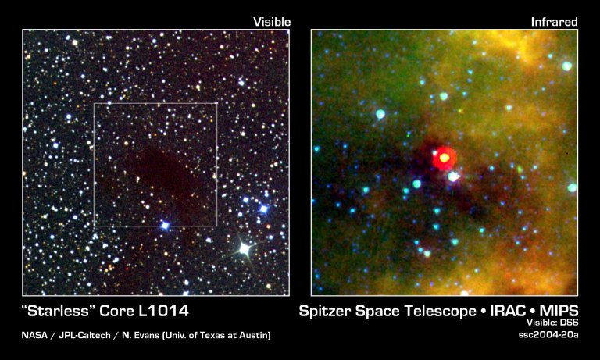

Very Low Luminosity Objects
(VeLLOs)
New class of protostars discovered by the Spitzer Space Telescope
0.001 L_{sun} < L < 0.1 L_{sun}
Either very young or old and currently in a slow accretion phase
Age can be estimated by looking at molecular outflows
NASA Images http://www.nasaimages.org/luna/servlet/detail/nasaNAS~12~12
~64235~168667:The-Starless-Core-That-Isn-t

Slide 3
Molecular Outflows
Partially ionized gas in the protostar’s accretion disk becomes caught in its magnetic field
Magnetic field causes gas to be ejected in bipolar jets
Jets sweep out material in the surrounding cloud
The blue or red shifted velocities of this material can be directly observed

Slide 4
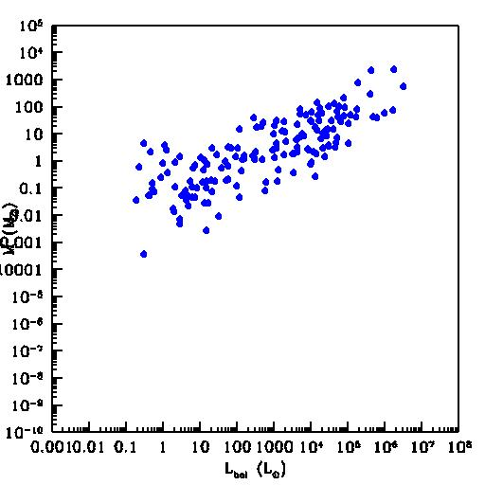
There is a relationship between the mass of the outflow and the luminosity of the protostar.
Does this correlation extend to VeLLOs?
Wu et al. 2004

Slide 5
Methods
50 embedded protostars from Dunham et al. 2008
Average luminosity: 0.098 L_{sun}
Observations were made using the Submillimeter Telescope (SMT) on Mt. Graham.
J=2-1 transition of ¹²CO (230 GHz) and ¹³CO (220 GHz)
A five point map with 30 arc second spacing was obtained for each source.
If the spectrum has a red or blue wing an outflow may be present.

Slide 6
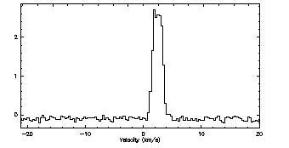
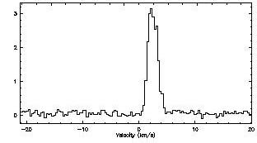
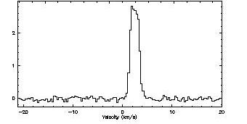
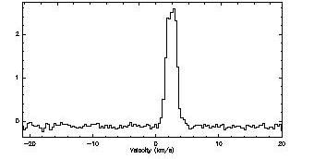
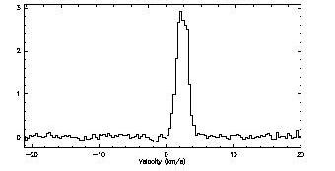
Results
L1148_32 ¹²CO (2-1)

Slide 7
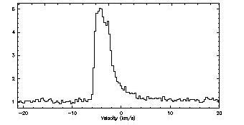
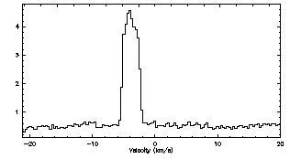
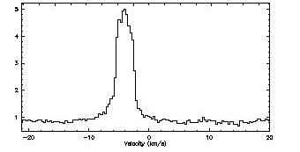
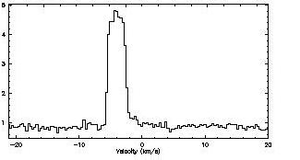
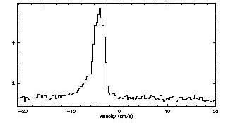
Results
L1251_44 ¹²CO (2-1)

Slide 8
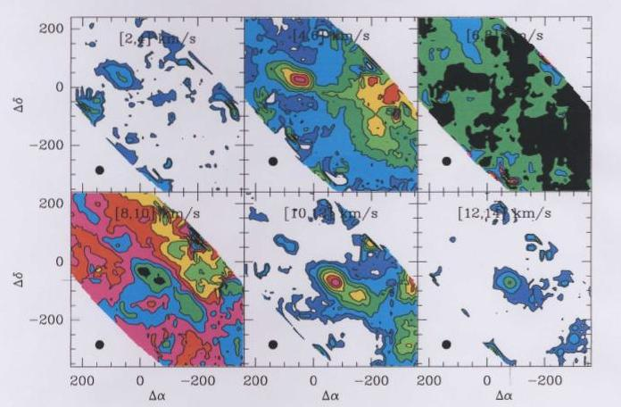
L673_31
t_{outflow} ≥ 57,070 yrs
M_{outflow} = 4.7*10⁻⁴ M_{sun}

Slide 9
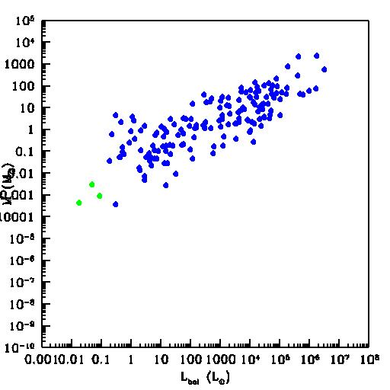
Results

Slide 10
Interpretations
The relationship between luminosity and outflow mass extends to low luminosity protostars
Most VeLLOs are in a low accretion state and do not drive large outflows
L673_31 had a much greater accretion rate in the past
Protostellar accretion is episodic

Slide 11
Acknowledgements
Yancy Shirley, Steward Observatory
Mike Dunham, University of Texas at Austin
Arizona Space Grant Consortium
Thank You

